Slide 1
電気回路演習I 02_電気回路の基礎・オームの法則・抵抗
水戸 慎一郎

Slide 2
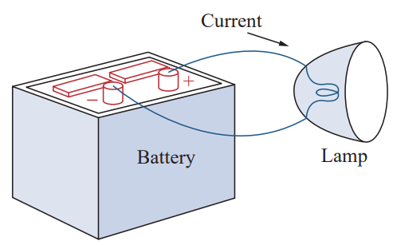
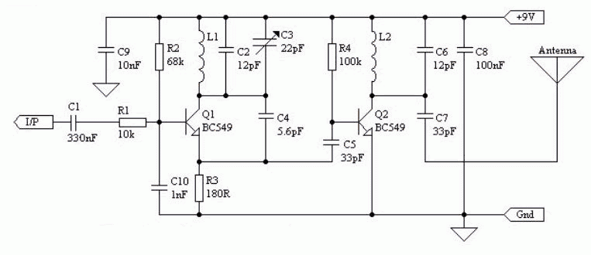
Concept of Electrical Circuit
An electric circuit is a group of electrical parts connected together.
The picture on the left shows a simple circuit with three basic parts: a battery, a lamp, and wires.
The picture on the right shows a real circuit, which is much more complicated.
A simple electric circuit
Example of low power FM Transmission circuit

Slide 3
Concept of Electrical Circuit
When a cell (or battery) is connected to a lamp, as shown in the picture, the lamp lights up.
This happens because electricity flows from the cell. In fact, tiny particles called electrons move from the negative terminal to the positive terminal. These moving electrons make the lamp light up.
Electrons have a negative charge. To describe electric current, we say that positive charges move from the positive terminal to the negative terminal. This flow of positive charge is called electric current and is written as I.
A cell, battery, or power source gives energy to a circuit. This energy is called electromotive force (EMF). EMF is what pushes the electric current to move through a circuit. In other words, a current can only flow if there is an EMF to start it.
A simple electric circuit

Slide 4
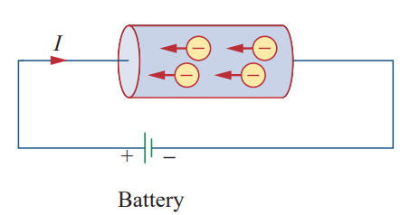
Charge and Current
The most basic idea in an electric circuit is electric charge. Charge is a property of tiny particles (like electrons) that make up everything around us. We measure charge in coulombs (C). One coulomb has about 6.24 × 10¹⁸ electrons.
Charge cannot be created or destroyed. It can only move from one place to another. This rule is called the law of conservation of charge.
When a wire is connected to a battery, the battery pushes the charges and makes them move. Positive charges move in one direction, and negative charges move in the other. This movement is called electric current. By tradition, we say that electric current flows in the direction of the positive charges.
Electric current is how fast electric charge moves over time. It is measured in amperes (A).

Slide 5
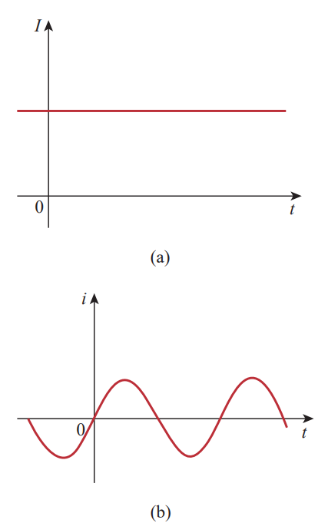
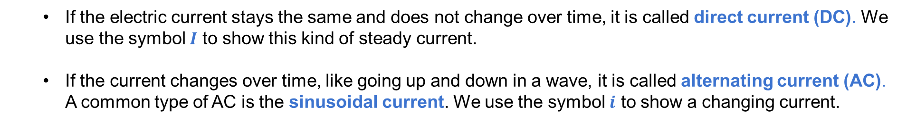

(Electric) Current
Current refers to the flow of electric charge in a circuit. The relationship between current 𝑖, charge 𝑞, and time 𝑡 is
$$i=\frac{dq}{dt}$$
where current is measured in amperes (A), and 1 ampere [A] = 1 coulomb/second [C/s].
If the electric current stays the same and does not change over time, it is called direct current (DC). We use the symbol $I$ to show this kind of steady current.
If the current changes over time, like going up and down in a wave, it is called alternating current (AC). A common type of AC is the sinusoidal current. We use the symbol $i$ to show a changing current.
Direct current (DC)
Alternating current (AC)

Slide 6
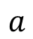
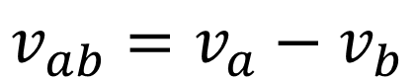
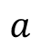
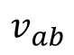
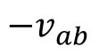
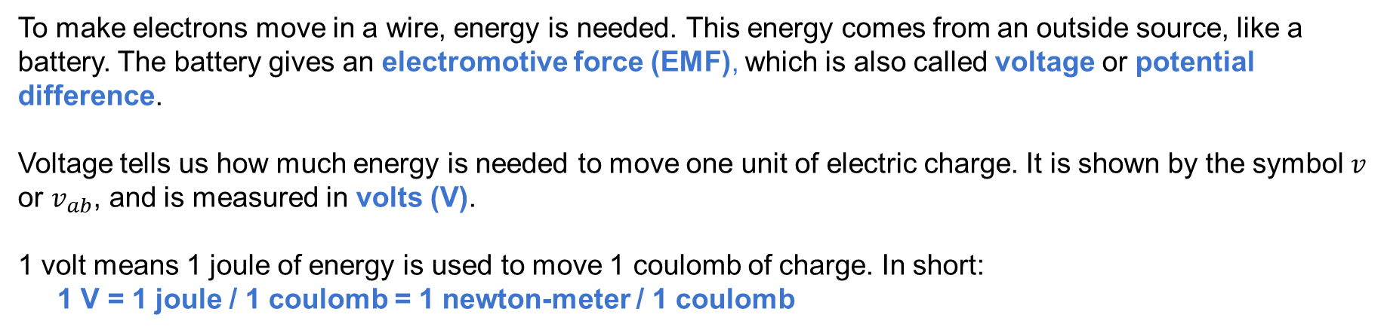
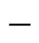
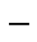

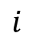
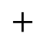
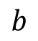
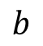
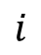
Voltage
To make electrons move in a wire, energy is needed. This energy comes from an outside source, like a battery. The battery gives an electromotive force (EMF), which is also called voltage or potential difference.
Voltage tells us how much energy is needed to move one unit of electric charge. It is shown by the symbol 𝑣 or $v_{ab}$, and is measured in volts (V).
1 volt means 1 joule of energy is used to move 1 coulomb of charge. In short:
1 V = 1 joule / 1 coulomb = 1 newton-meter / 1 coulomb
voltage drop from a to b
$$i$$
$$a$$
$$i$$
$$a$$
$$+$$
$$+$$
$$v_{ab}=v_{a}−v_{b}$$
$$v_{ab}$$
$${−v}_{ab}$$
$$−$$
voltage at point a
(higher)
voltage at point b (lower)
$$b$$
$$−$$
$$b$$

Slide 7
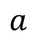
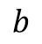
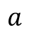
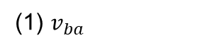
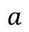
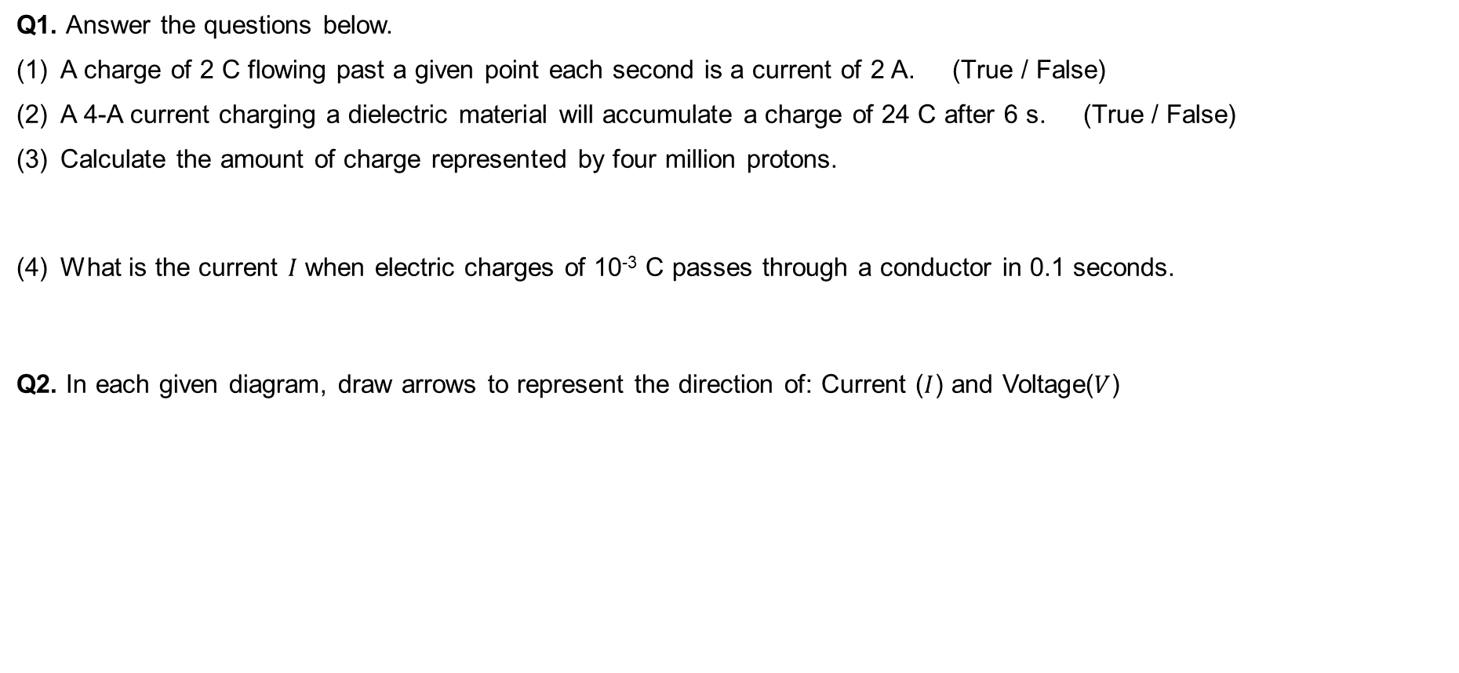




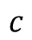
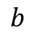
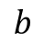
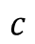
Exercise
Q1. Answer the questions below.
A charge of 2 C flowing past a given point each second is a current of 2 A. (True / False)
A 4-A current charging a dielectric material will accumulate a charge of 24 C after 6 s. (True / False)
Calculate the amount of charge represented by four million protons.
What is the current 𝐼 when electric charges of 10⁻³ C passes through a conductor in 0.1 seconds.
Q2. In each given diagram, draw arrows to represent the direction of: Current ($I$) and Voltage($V$)
Hint: Charge of 1 proton = 1.602 × 10⁻¹⁹ C
(1) $v_{ba}$
(2) ${v_{ab},v_{bc},v_{ac}; v}_{ac}>v_{bc}$
(3) ${v_{ab},{−v}_{ca}; v}_{c}>v_{a}$
$$a$$
$$−$$
$$+$$
$$b$$
$$a$$
$$b$$
$$c$$
$$a$$
$$b$$
$$c$$

Slide 8
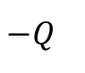
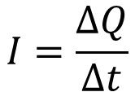
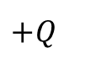
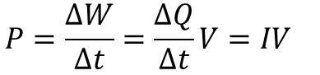
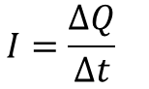
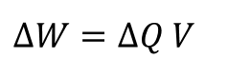
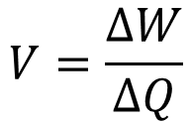
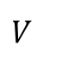
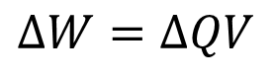
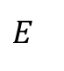
How Electric Current, Voltage, and Energy Work Together
When an electric charge ∆𝑄 (in coulombs, C) flows through a circuit over a time interval ∆𝑡 (s), the electric current 𝐼 (A) is given by:
As mentioned earlier, for a current 𝐼 to flow, a voltage 𝑉 (in volts, V) must be applied across the load (e.g., a lamp). In this case, the electromotive force (EMF) 𝐸 is equal to 𝑉. The work done (or electric energy) ∆𝑊 (J) by moving the charge ∆𝑄 is given by:
Therefore, the voltage 𝑉 can be defined as:
$$I=\frac{∆Q}{∆t}$$
positive charge
current
$$+Q$$
+
$$I=\frac{∆Q}{∆t}$$
$$∆W=∆QV$$
+
electric cell
(battery)
element
(lamp)
$$E$$
$$V$$
$$V=\frac{∆W}{∆Q}$$
-
$$∆W=∆Q V$$
negative charge
$$P=\frac{∆W}{∆t}=\frac{∆Q}{∆t}V=IV$$
-
$$−Q$$

Slide 9
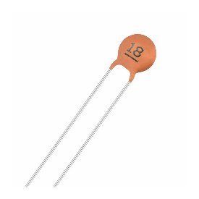
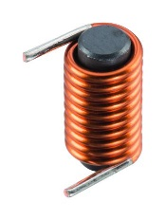
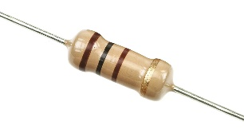
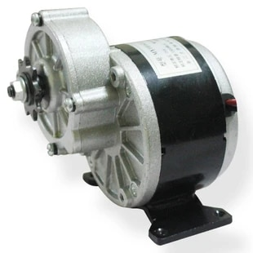
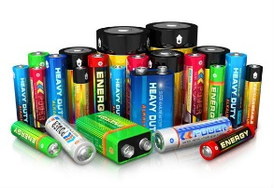
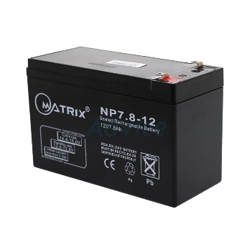
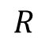
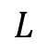
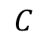
Circuit Elements
An electric circuit is simply a connection of different components.
These components can be classified into two types: active elements and passive elements. Active elements can supply energy to the circuit (for example, batteries or power sources),
while passive elements cannot generate energy; they only consume or store it (such as resistors, capacitors, and inductors).
Passive elements
$$R$$
$$C$$
$$L$$
Resistor
Capacitor
Inductor
+
+
+
+
-
Active elements
or
Single and double battery cell
Multiple battery cell
Generator

Slide 10
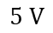
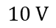
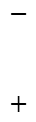





Exercise
Q1. An energy source provides a constant current of 2 A for 10 seconds to a lightbulb. If 2.3 kJ (kilojoules) of energy is used as light and heat:
Calculate the amount of electric charge (∆𝑄) that flows through the conductor in 10 seconds.
Calculate the voltage (𝑉) across the lightbulb.
Q2. Calculate the power absorbed by each element in the circuit.
$$4 A$$
$$2 A$$
$$−3 A$$
$$+$$
$$−$$
$$+$$
$$−$$
$$+$$
$$−$$
$$10 V$$
$$12 V$$
$$5 V$$

Slide 11
Exercise
Q3. An electric heater uses 300 W of power when a voltage of 100 V is applied.
Answer the following:
Calculate the current 𝐼 flowing through the electric heater.
Calculate the total electric energy 𝑊 consumed when the heater is used 1 hour per day for 30 days.
Q4. Electric energy is converted into heat at a rate of 112 J/s (watts) in a resistor. If the current through the resistor is 4 A, calculate the voltage 𝑉 across it.

Slide 12




Ohm’s Law
When connecting a circuit and applying the same voltage ($E$) to two materials of equal size ($\text{A} \text{and} \text{B}$), we can measure the current ($I$) flowing through them along with the corresponding voltage drop ($V$), as shown in the diagram.
We observed that the current of both A and B is in the same relation with voltage by some constant.
$$I$$
Ammeter
A
A
$$E$$
$$V(=E)$$
A
B
B
V
Power
source
Voltmeter
Resistor
Experiment of relationship between $E$ and $I$
Results of measured currents for changes in voltage

Slide 13








Ohm’s Law
Ohm’s law states that the voltage $v$ across a resistor is directly proportional to the current $i$ flowing through the resistor.
Ohm defined the constant of proportionality for a resistor to be the resistance, $R$. It’s measured in the unit of ohms, designated $Ω$, 1 $Ω$ = 1 $\text{V}\text{/}\text{A}$
Conductance (𝐺) [S] is a value that shows how easily current flows when voltage is applied. It describes the relationship between current and voltage.
$$I$$
$$I$$
$$I=GE$$
$$E$$
Part of
Material
A
$$V(=E)$$
Resistance (𝑅) [Ω] is a value that opposes the flow of electric current.
It is the inverse of conductance.
Power source
$$G=\frac{1}{R}$$
Electrical Circuit
$$I=\frac{E}{R} or E=RI$$

Slide 14

Exercise
Q1. We measured the relationship between voltage and current. The results are shown on the graph.
Answer the questions below.
(1) Calculate the conductance ($G_{A}$ and $G_{B}$) of the resistor of A and B.
(2) Calculate the resistance ($R_{A}$ and $R_{B}$) of the resistor of A and B.
(3) Which resistor has bigger resistance?
A
B
Results of measured currents for changes in voltage

Slide 15






Resistance
Most materials naturally resist the flow of electric charge. This property is called resistance, and it is represented by the symbol 𝑅. Resistance can be expressed using the formula:
Material | Resistivity, $ρ [Ωm]$ | Conductivity, $σ [S/m]$
Silver | 1.59×10⁻⁸ | 6.30×10⁷
Copper | 1.68×10⁻⁸ | 5.96×10⁷
Gold | 2.44×10⁻⁸ | 4.11×10⁷
Aluminum | 2.65×10⁻⁸ | 3.77×10⁷
Carbon | 5.0×10⁻⁶ | 2.0×10⁵
Sea water | 2.0×10⁻¹ | 4.8
Wood (dry) | 10¹⁴ | 10⁻¹⁴
Glass | 10¹¹ to 10¹⁵ | 10⁻¹⁵ to 10⁻¹¹
Air | 10⁹ to 10¹⁵ | 10⁻¹⁵ to 10⁻⁹
Length, $ℓ$
$$R=ρ\frac{ℓ}{A}=\frac{ℓ}{σA}$$
Material with
resistivity,$ρ$
Cross-sectional area $A$
$ρ$: resistivity [$Ωm$]
$σ$: conductivity [$S/m$]
Resistance increases with length and resistivity, and decreases with area and conductivity.
It also depends on temperature—resistance usually increases as temperature rises.

Slide 16


Exercise
Q2. Answer the questions against the resistor on the right-hand side.
(1) Find the resistance $R$ of the resistor.
(2) If the radius and length of the resistor are doubled, what is the resistance value times the above?
Q3. Calculate the resistance when radius and length of a resistor (copper) are 0.1 mm and 1 m, respectively.

Slide 17


Resistor
A resistor is an electrical component designed to limit or control the flow of electric current in a circuit. It is made from various materials and is used to regulate the amount of current that passes through it.
(a) (b)
(c) (d)
(a) Inside the resistor, a carbon film is wrapped around an insulator.
(b) A symbol for fixed-resistor
(c) Real variable resistor and
(d) A symbol of variable resistor

Slide 18






Resistor makes voltage drop
water level: High
$$I$$
$$I$$
Electric potential: High
$$E$$
$$V$$
Pump
$$R$$
Power source
Electric potential: Low
water level: Low
Electrical Circuit
Water Circulation
A power source (such as a battery) is a device that increases electric potential. This increase is called the electromotive force (EMF) and is represented by the voltage 𝐸.
When electric current flows through a resistor, the electric potential decreases across the resistor. This decrease is called the voltage drop and is represented by 𝑉.
$$E=V=RI [V]$$

Slide 19





Exercise
Q4. In an electric circuit with $E=10 V$ and $R=10 Ω$, answer the questions below:
What is the voltage 𝑉 across the resistor?
What is the current 𝐼 flowing through the circuit?
Q5. In an electrical circuit with $E=5 V$, answer the questions below:
What is the resistance 𝑅 if the current is 𝐼 = 2 A?
What is the voltage 𝑉 across the resistor?
$$I$$
$$E$$
$$R$$
$$V$$

